Slide 1


DESIGN 1
Lesson 3: Build an F1 Website: Four Pages
Ms. Abboud • Grade 9 - Design 1 • Term 1, Week 5

Slide 2
Learning Objectives
WALT - We Are Learning To
WILF - What I'm Looking For
Build a website with four pages from scratch.
Use headings, paragraphs and lists to organise the content.
All 4 files are created with the correct names.
Each page shows its heading and text in the browser.

Slide 3
Frayer Model: Relative Link (Review)
DEFINITION
CHARACTERISTICS
A link using just a filename or short path (e.g. about.html) to point to another page within the same project.
Just a filename/path; no https://; points within the same project.
RELATIVE LINK
EXAMPLES
NON-EXAMPLES
href="about.html"
href="https://www.wikipedia.org" (an absolute link)

Slide 4
National Identity Integration
UAE Government Digital Services: UAE government and company websites share the same core pages, like About Us, Vision and Mission, and Contact Us, so people always know where to look. Today you build that same structure for an F1 website, the sport of the Abu Dhabi Grand Prix.

Slide 5
STARTER
Which Pages Does Every Website Have?
Think of a website you use often.
Which pages does it almost always have? Name 3.
Hook • Engage & Ask
5 - 10 minutes

Slide 6
LESSON CORE
I Do: One Folder, Four Files
Every page is its own .html file, saved in the same folder.
Every page starts with the same skeleton. Only the title and the text change.
Gradual Release of Responsibility
30 - 40 minutes
Example: the Home page (index.html)
<!DOCTYPE html>
<html>
<head>
<title>F1 World - Home</title>
</head>
<body>
<h1>Welcome to F1 World</h1>
</body>
</html>
1 / 3

Slide 7
LESSON CORE
We Do: Build the Home Page Together
Create index.html and type the Home page text with me.
Save, then open it in the browser to check.
File names: index.html, about.html, contact.html, vision.html
Gradual Release of Responsibility
30 - 40 minutes
2 / 3

Slide 8
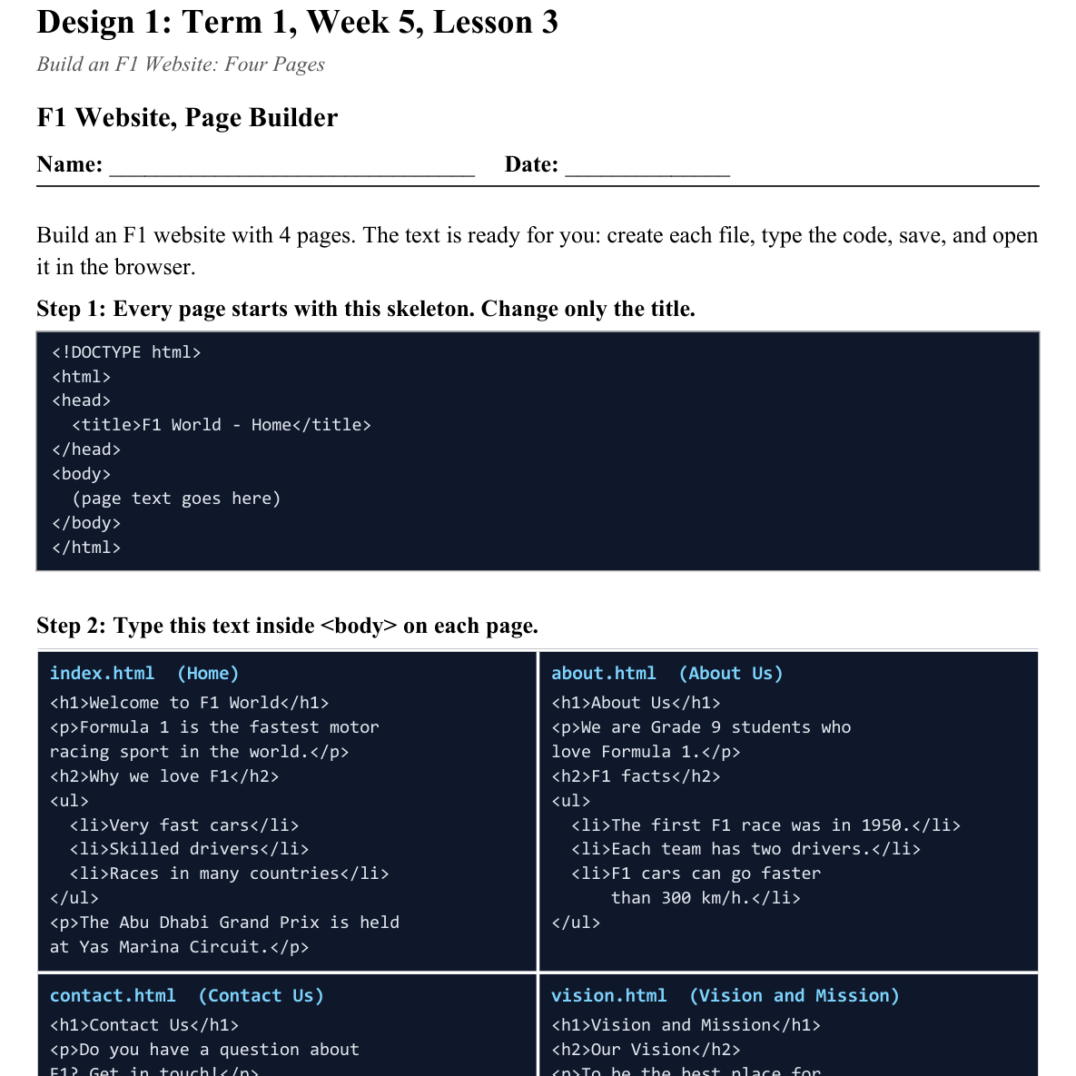
LESSON CORE
You Do: Build the Other Pages
Create about.html, contact.html and vision.html.
Type the text from your sheet, save, and check each page in the browser.
Activity: F1 Website, Page Builder
Gradual Release of Responsibility
30 - 40 minutes
3 / 3

Slide 9
CLOSURE
Quick Check
Show your teacher all 4 pages open in the browser.
Next lesson: we connect them with hyperlinks.
Transition & Extend
5 - 10 minutes

